Slide 1
14.485 Capstone Design Civil and Environmental Engineering
Spring 2014 | Section 201 | Team #1
Anas Al Sayed Ali
Thomas Duval, E.I.T.
Ana Gouveia, E.I.T.
Sarah Shaw
Notes:
Good Evening everyone! Thank you all so much for attending our capstone design presentation. My name is Ana Gouveia and We are Team #1.

Slide 2
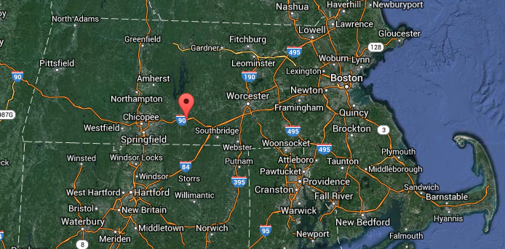
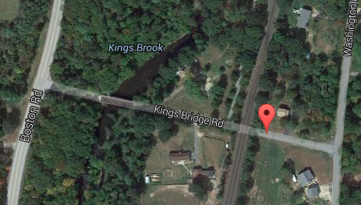
BRIDGE DESIGN INTRODUCTION
2014 Capstone Project: Design Brimfield, MA, Kings Bridge Road Replacement Bridge.
Figure 2. Overview of Massachusetts and Brimfield, MA.
Figure 1. Aerial View of Kings Bridge Rd.
Notes:
The 2014 Capstone Project consisted of the design of the Brimfield/Palmer replacement bridge, which carries Kings Bridge Road over the Quaboag River in Brimfield, MA.
As you can see in figure 1… and figure 2

Slide 3
BRIDGE DESIGN INTRODUCTION
Notes:
Further, In order to successfully design this bridge, As you can see in the chart, four civil engineering elements had to be prepared and come together in order to satisfy current state regulations & project budget.
The following modules to be presented and that were executed throughout this semester were mainly focused on designing each one of these elements and will be presented by students that hope to pursuit the following areas as their concentrations in their careers as civil engineers.

Slide 4
Transportation
Presented by: Thomas Duval, E.I.T.
Notes:
Please welcome, Thomas Duval, EIT presenting the Transportation Module.

Slide 5
HIGHWAY & BRIDGE GEOMETRY
Bridge Span: 170’
Bridge Cross Section: 86’9” composed of –
4 Lanes @ 12’-0”
2 Shoulder/ Bicycle Lanes @ 10’-0”
2 Sidewalks @ 8’0”
S3-PL2 Bridge Rail @ 16.5”
Substructure: Strip Abutment
Superstructure: Single Span Composite Steel Plate Girders with Reinforced Concrete Deck
Environmental: 100-year flood clearance and wetland area.

Slide 6
HIGHWAY & BRIDGE GEOMETRY
Thermal Movement
MassDOT LRFD 3.1.8.1 defines the max one-way thermal movement for design of structural components to be:
δT = Lα∆T
L = (170 ft / 2)(12 in) = 1,020 in
α = 6.5 x 10^6 (coefficient of thermal expansion for structural steel)
∆T = 100˚ F (temp. fall from assumed ambient temp. of 70˚ F)
δT = 0.7 in

Slide 7
HIGHWAY & BRIDGE GEOMETRY
Depth of Girder:
Minimum Depth = 0.033L
Overall Depth of Comp. Beam = 0.040L
0.033(170 ft)(12 in / ft) = 68 in
0.040(170 ft)(12 in /ft) = 84 in
84 in - 8 in (deck) = 76 in = 6.3 ft

Slide 8
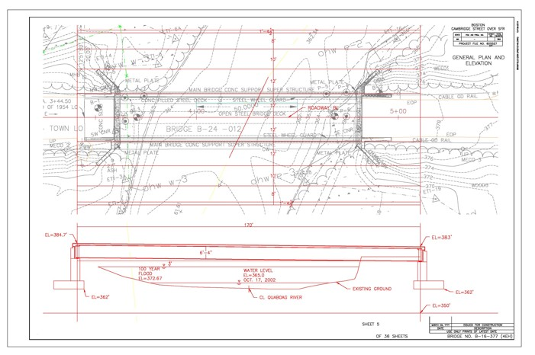
HIGHWAY & BRIDGE GEOMETRY
Figure 3. General Plan and Elevation

Slide 9
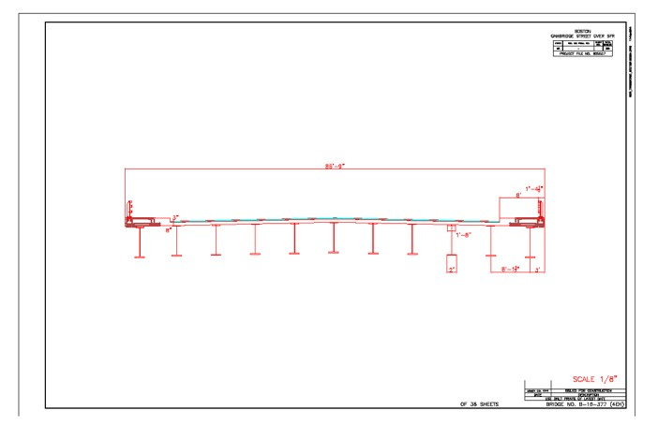
HIGHWAY & BRIDGE GEOMETRY
Figure 4. Transverse Section of Bridge

Slide 10
Geotechnical
Presented by: Thomas Duval, E.I.T.
Ana Gouveia, E.I.T.

Slide 11
GEOTECHNICAL ENGINEERING
Corrections to SPT N Values
N_{measured} = Raw SPT Value from Field Test (ASTM D1586-11)
Energy correction:
Normalizing correction:
N₆₀ = Corrected N Values Corresponding to 60% Energy Efficiency
N₆₀ = C_{E}C_{B}C_{S}C_{R}N_{measured}
C_{E} = Energy Ratio
C_{B} = Borehole Diameter
C_{S} = Sampling Method
C_{R} = Rod Length
(N₁)₆₀ = N₆₀ Values Normalized to 1 Atmosphere Overburden Stress
(N₁)₆₀ = C_{N}N₆₀
C_{N} = (P_{a}/σ’_{VO})^{n}
P_{a} = Atmospheric Pressure (1 atm = 14.7 psi = 2116 psf)
σ’_{VO} = Insitu Vertical Effective Stress (n = 0.5 to 0.6 for sands)

Slide 12
GEOTECHNICAL ENGINEERING
Effective Friction Angle
Effective Friction Angle, φ’ , Calculated with Meyerhoff (1996) Correlations:
φ’ = [15.4(N₁)₆₀]^{(1/2)} + 20˚
φ’ = 37˚ (Averaged)

Slide 13
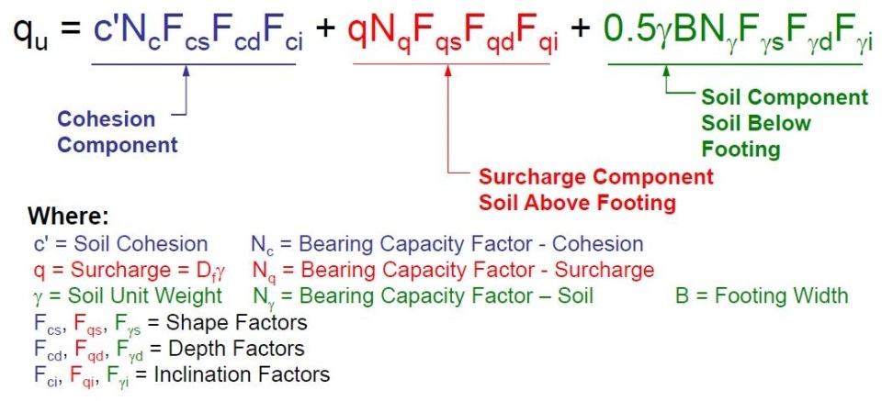
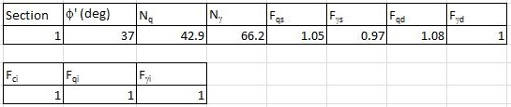
GEOTECHNICAL ENGINEERING
General Bearing Capacity Equation
Figure 5. Bearing Capacity Equation ((Meyerhof, 1963) Hajduk, 2014)
Figure 6. Shape, Depth, and Inclination Factors

Slide 14
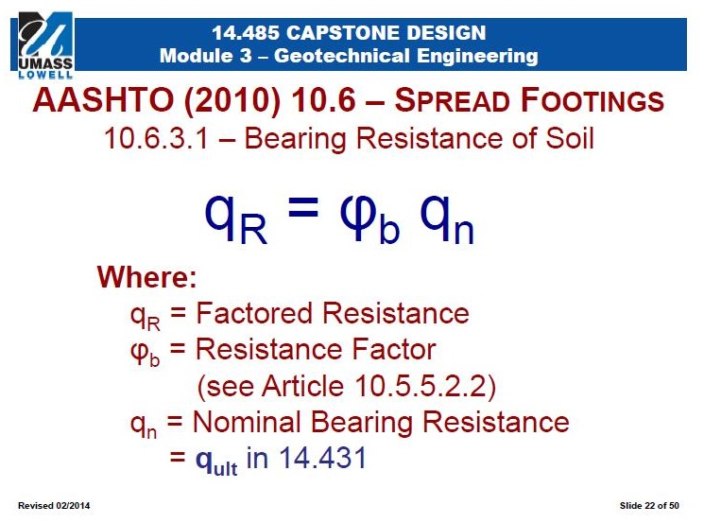
GEOTECHNICAL ENGINEERING
Bearing Resistance of Soil
ϕ_{b} = 0.45
q_{n} = q_{u} = 52.6 ksf
q_{R} = 23.67 ksf
Figure 7. Bearing Resistance of Soil Equation ((AASHTO 10.6, 2010) Hajduk, 2014)

Slide 15
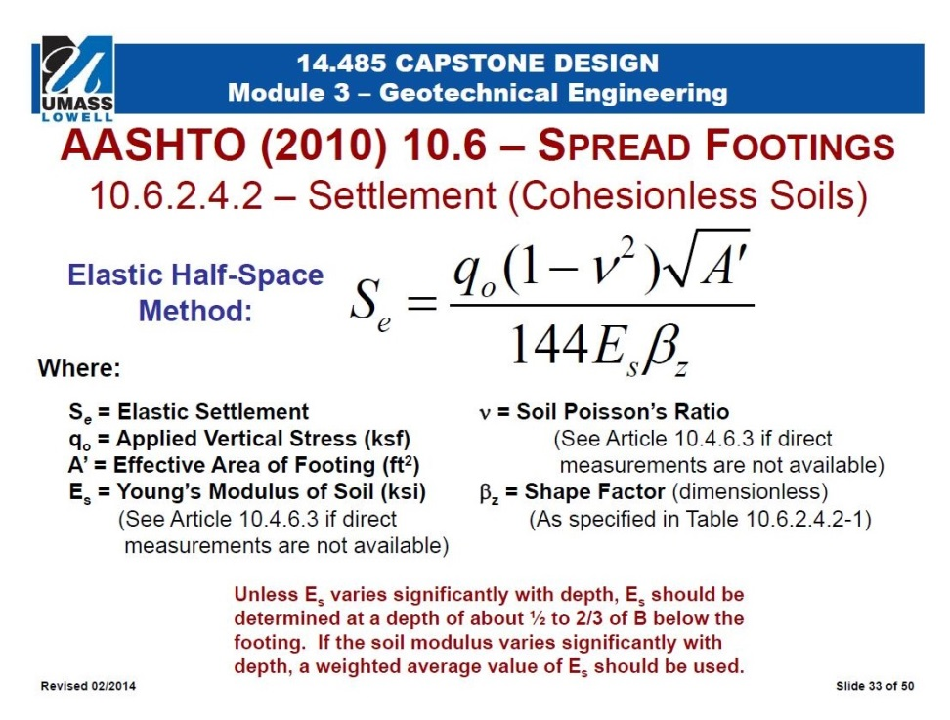
GEOTECHNICAL ENGINEERING
Calculation of Applied Vertical Stress
Given Maximum Settlement, S_{e}, of 1 in, Elastic Half-Space Method Used to Calc. Applied Vertical Stress, q₀
q₀ = 32.6 ksf
Figure 8. Elastic Half-Space Settlement Equation ((AASHTO 10.6) Hajduk, 2014)

Slide 16
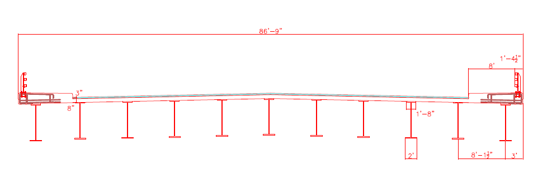
ABUTMENT DESIGN
Loading Considerations:
Dead Loads: See Figure 3.
Live Loads: HL-93 Truck & Lane Load of 640 plf
Seismic & Wind Loads: Given
Strength I Min. and Service I. Factors Used
Figure 9. Transverse Section
Notes:
For the abutment design, it was necessary to compute dead & live loads. These values were o

Slide 17
ABUTMENT DESIGN
Abutment Dimensions & Design:
Height: 22’0”
Stem Thickness: 4’6”
Footing Width: 15’0”
Toe Width: 2’0”
Footing Thickness: 2’6”
Safety Checks:
Earth Pressures, Vertical & Horizontal forces and moments about Toe and Stem were obtained.
Results checked stability, eccentricity, bearing and sliding.

Slide 18
Structural
Presented by: Anas Al Sayed Ali

Slide 19
REINFORCED CONCRETE DESIGN
Determine Reinforcement on Footing according to AASHTO and MassDOT specifications
Assess 4 specific re-bars within the abutment design:
Footing (1)
Abutment Stem (1)
Abutment Backwall (1)
Abutment Bearing Seat (1)
Check if these reinforcement bars will maintain force loads and bearing pressures of the settlement and concrete
Figure 10. Abutment
Reinforcement Locations

Slide 20
REINFORCED CONCRETE DESIGN
Determine Ultimate Moment (Mu)
Determine Moment of Inertia (Ig )
Ig = (b × h^3) / 12
Determine Section Modulus (Sc)
Sc = Ig / (h/2)
Determine Modulus of Rupture (fr)
Fr = 0.24 × (fcp) ^0.5
Determine Cracking Moment (Mcr )
Mcr = Sc × fr
Compare 1.2* Mcr & 1.33Mu (LRFD)

Slide 21
REINFORCED CONCRETE DESIGN
Design Moments, Re-bar size and spacing used were determined as follow:
Table 1. Abutment Reinforcement Values
Location
1.33*Mu
1.2*Mcr
?Mn
k-ft
k-ft
k-ft
Rebar
Spacing
Back of Stem wall @ bottom
90.69
279.94
137.86
#8
12"
*As(req) = 0.79
Top of Heel
98.08
86.4
95.7
#12
12"
*As(req) = 2.25
Inside face of backwall
58.26
22.3
26.88
#10
12"
*As(req) = 1.27
Outside face of backwall
33.89
22.3
26.88
#10
12"
*As(req) = 2.25
*Check Minimum Temp and Shrinkage Reinforcement Based on 2009 MassDOT BR. Man. 3.1.3

Slide 22
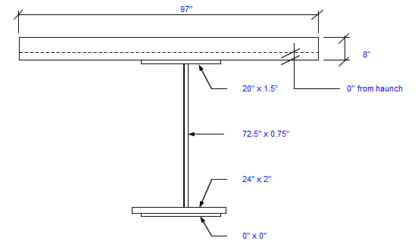
SUPERSTRUCTURE DESIGN
Girder Dimensions:
Top flange: Thickness = 1.5 in
Width = 20 in
Bottom Flange: Thickness = 2 in
Width = 24 in
Web: Thickness = 0.75 in
Depth = 72.50 in
Spacing: 8.08 ft
Figure 11. Composite Steel Beam and Girder Cross-Section
Concrete Slab Dimensions:
Thickness = 8 in
Effective Width = 97 in
Pavement Dimensions:
Base Pave Thickness = 1.5 in
Surface Pavement = 1.5 in

Slide 23
SUPERSTRUCTURE DESIGN
Material Properties:
F’c = 4 ksi
Fy (Girder) = 50 ksi
Fy (rebar) = 60 ksi
Ec = 57*(4000)^1/2
Ec = 3605 ksi
Es = 29000 ksi
n (Es/Ec) = 8

Slide 24


SUPERSTRUCTURE DESIGN
Deflection Calculations:
Table 2. Total Deflection results at each of the distances x, ft from the support.
Deflection by Dead Load:
x(ft) | Deflection (in)
0 | 0.0000
17 | 2.4271
34 | 4.5999
51 | 6.3118
68 | 7.4085
85 | 7.7880
102 | 7.4006
119 | 6.2486
136 | 4.3867
153 | 2.1349
170 | 0
𝞭=$\frac{Wx}{24EI}[l^{3}−2lx^{2}+x^{3}]$
Deflection by Live Load:
$δ=\frac{Px}{12EI}(\frac{3L^{2}}{4}$-$x^{2})$

Slide 25
Environmental
Presented by: Sarah Shaw

Slide 26
DRAINAGE AND EROSION CONTROL
Objectives:
Prepare Roadway Drainage Design for Brimfield/Palmer Bridge End of Site
Determine 10 year storm event peak discharge
Compute Hillside, Bridge, & Roadway Drainage Areas
Calculate Required Manhole Inlet & Outlet Elevations
Compute Required Drainpipe Sizes

Slide 27
DRAINAGE AND EROSION CONTROL
Module 7
Reference: MassDOT Highway Design Guide, 2006, Section 8-110
Rational Method:
Q = C i A
where:
Q = peak discharge (cfs)
C = runoff coefficient
i = rainfall intensity (in/hr)
A = drainage area (acres)

Slide 28
DRAINAGE AND EROSION CONTROL
Module 7
Runoff Coefficient (C)
MassDOT Exhibit 8-8: hillside coefficient of 0.25 (woodland surface)
MassDOT Exhibit 8-9: bridge & roadway surface coefficient of 0.95 (pavement)
Drainage Area (A)
Bridge & Roadway Areas: 0.34 acres and 1.34 acres respectively
Hillside Area: 95 acres
Calculated from AutoCAD
Drainage Area Determined from Top of Hillside to Washington Road

Slide 29
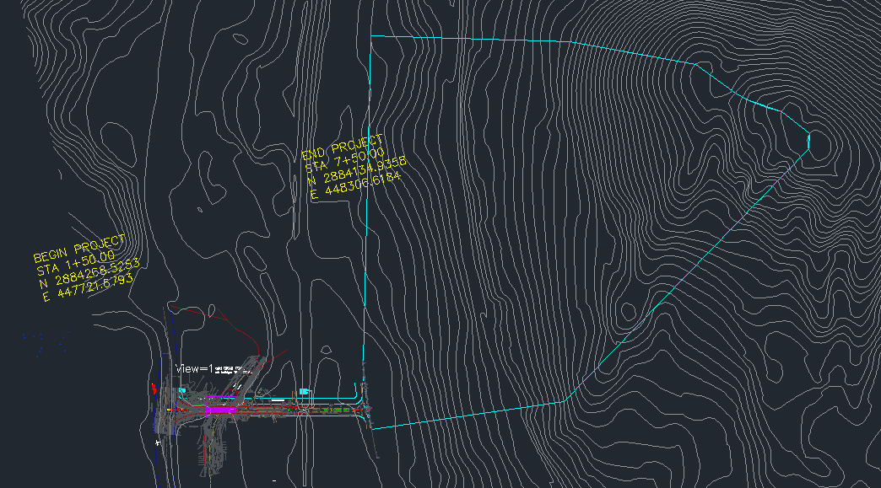
DRAINAGE AND EROSION CONTROL
Module 7
Figure 12. CAD drawing of the Area studied

Slide 30
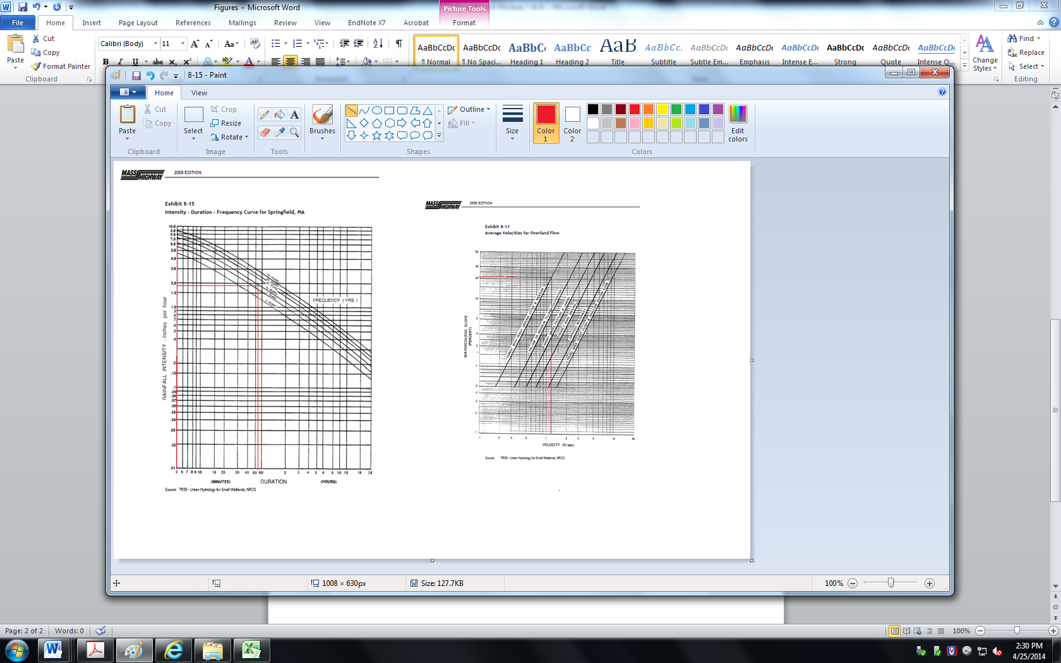
DRAINAGE AND EROSION CONTROL
Module 7
Rainfall Intensity (i)
Hill Drainage Area
Watercourse Slope = 21%
Exhibit 8-11 Yields Average Velocity of Overland Flow: 1.2 ft/s
Travel Time: 53 minutes
Exhibit 8-15 Yields: i = 1.9 in/hr
Bridge & Roadway Area
Travel Time: 5 minutes
Rainfall Intensity: 6.2 in/hr
Figure 13. Mass Highway Design Chart

Slide 31
DRAINAGE AND EROSION CONTROL
Peak Discharge Results:
Table 3. Manhole Locations and Runoff values obtained

Slide 32
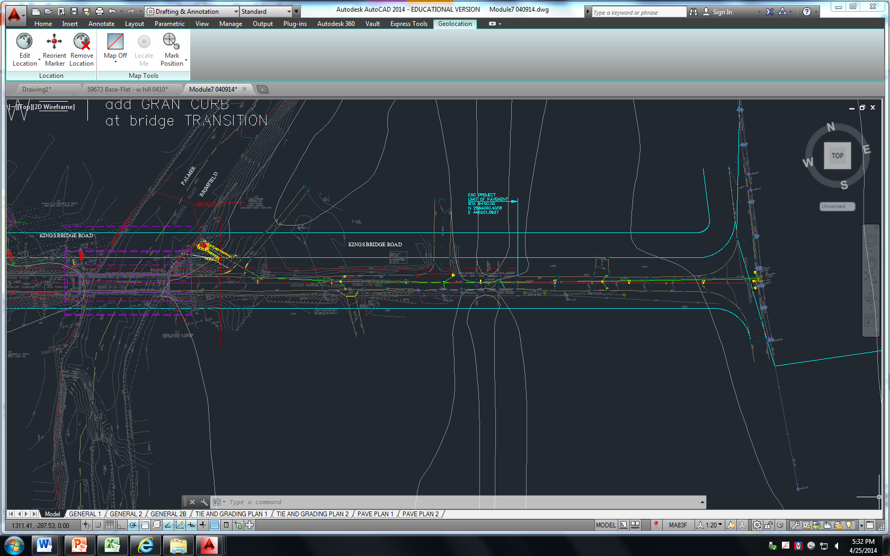
DRAINAGE AND EROSION CONTROL
Module 7
Inlet/Outlet Elevations
Figure 14. Mass Highway Design Chart

Slide 33

DRAINAGE AND EROSION CONTROL
Module 7
Initial Ground Elevation, MH1: 383.4’
3’ Ground Cover
1% Total Downward Drainage Slope Along Roadway
Manhole 8’ Depth
Elevation of Final MH Lower Invert: 369.3’
River Elevation Near MH5: 365’
Table 4. Manhole Locations and Vertical Controls

Slide 34
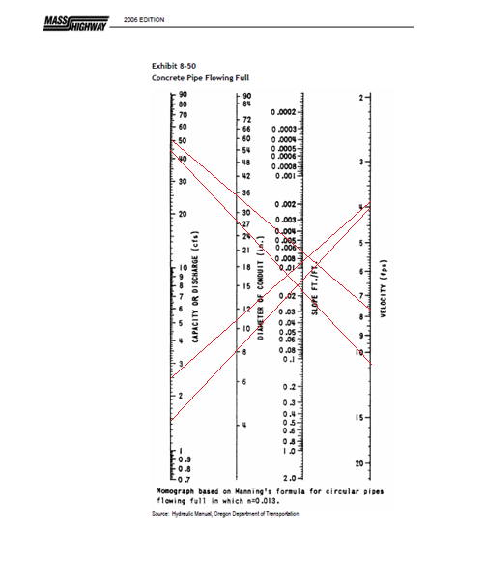
DRAINAGE AND EROSION CONTROL
Module 7
Drainage Pipe Diameter
MassDOT Exhibit 8-50
Manning’s Formula for Full Flowing Concrete Pipe
Pipe Size Dictated by Peak Discharge & Slope
Results:
With Hillside Drainage:
Range: 30-36 in
Without Hillside Drainage:
Range: 10-12 in
Figure 15. Mass Highway Design Chart

Slide 35
DRAINAGE AND EROSION CONTROL
Table 5. Pipe Diameters with Hillside Drainage:
Table 6. Pipe Diameters without Hillside Drainage:

Slide 36
ENVIRONMENTAL PERMITTING
Module 8
Determine Area of Required Wetland Fill
Compute Toe of Slope with 2:1 Side Slope Design Specification
Compose Informational Letter to MA DEP
Prepare 401 Water Quality Data Form

Slide 37
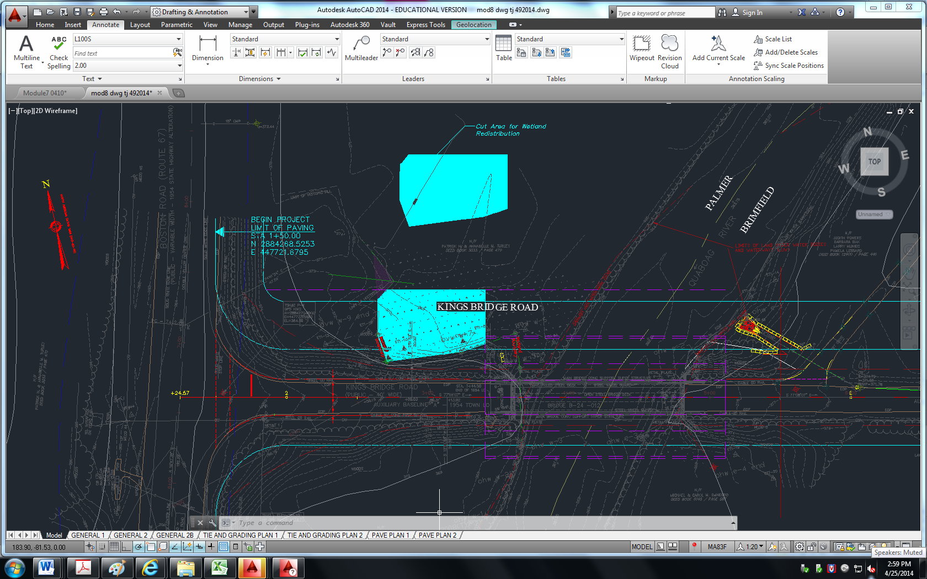
ENVIRONMENTAL PERMITTING
Survey Information Shows Area Bordering Vegetated Wetland (BVD): 3,432 ft²
Area of Disturbed BVD Must be Restored at Similar Elevation:
Figure 16. Area of Wetlands Displaced

Slide 38
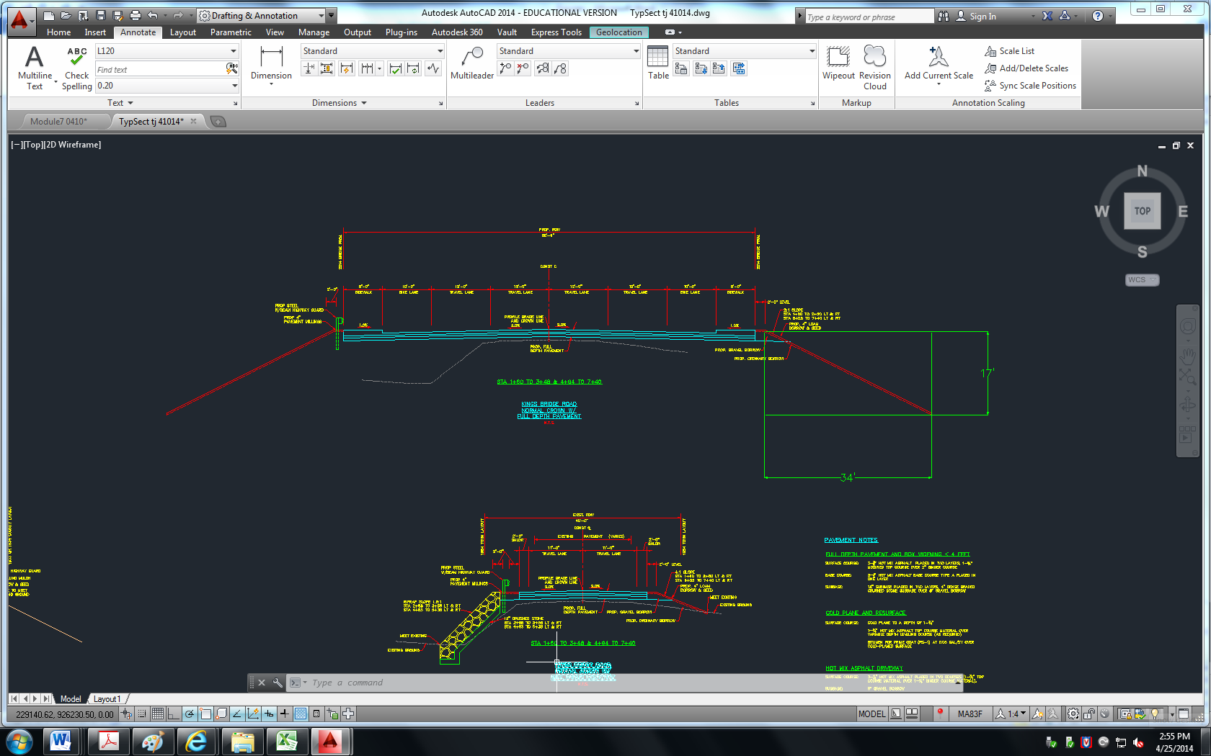
ENVIRONMENTAL PERMITTING
Required Side-Slope Specification of 2:1
Elevation Drop from Roadway to Wetland:17 feet
Resulting Horizontal Reach of Impacted BVD: 34 feet
Figure 17. Transverse Section of Roadway

Slide 39
ENVIRONMENTAL PERMITTING
Module 8
Letter to MA Department of Environmental Protection (MA DEP)
Project Detail Overview
401 Water Quality Certificate (401 WQC) Requirement Inquiry
401 WQC (USACE/Clean Water Act)
BRP WW 10 Major Project Classification
Non-Water Dependent DEP 310 CMR 10.04
ORW 314 CMR 4.06(2)
MEPA 301 CMR 11.01 (2)(a)

Slide 40
Construction Management
Presented by: Anas Al Sayed Ali
Sarah Shaw

Slide 41
CONSTRUCTION ESTIMATE
Module 9 dealt with the computation of quantities and cost of materials for the bridge construction.
Table 7. Preliminary Estimate of Quantities and Cost of Bridge
 |  | < PRELIMINARY ESTIMATE OF QUANTITIES AND COST OF BRIDGE >
Item No. | Total Quantity | Unit | Description | Unit Price | Total Cost
140. | 1826 | CY | Bridge Excavation | $22.00 | $40,172.00
151.2 | 1360 | CY | Gravel Borrow for Bridge Foundations | $24.00 | $32,640.00
455.61 | 114 | TON | Superpave Bridge Surface Course | $90.00 | $10,260.00
455.71 | 114 | TON | Superpave Bridge Protective Course | $130.00 | $14,820.00
904. | 680 | CY | 4000 PSI, 3/4 IN., 610 CEMENT CONCRETE | $550.00 | $374,000.00
904.3 | 175 | CY | 5000 PSI, 3/4 IN., 685 HP CEMENT CONCRETE | $1,650.00 | $288,750.00
904.4 | 370 | CY | 4000 PSI, 3/4 IN., 585 HP CEMENT CONCRETE | $950.00 | $351,500.00
960.502 | 64750 | LB | Structural Steel M270 Grade 50W Uncoated Plate Girder Bridge | $1.50 | $97,125.00
965. | 1660 | SY | Membrane Waterproofing for Bridge Decks | $22.00 | $36,520.00
971. | 176 | FT | Asphaltic Bridge Joint | $220.00 | $38,720.00
975.1 | 353 | FT | Metal Bridge Rail (3 RAIL), STEEL (S3-TL4) | $315.00 | $111,195.00
NOTE: All unit prices have been obtain from the MassHighway Weighted Average Book-November 2008
TOTAL | $1,395,702.00

Slide 42
MASSDOT SCOPE AND FEE
Module 10 dealt with the computation of quantities and cost of labor for the bridge construction.
Table 8. Design Costs summary
 |  |  |  |  | DESIGN |  | CONSTRUCTION |  |  | TOTALS
(a) Salary Costs |  |  |  |  | $ 206,917.70 |  | $ 16,716.24 |  |  | $ 223,633.94
(b) Indirect Costs (%) |  | 155.00% |  |  | $ 320,722.44 |  | $ 25,910.17 |  |  | $ 346,632.61
(c) Net Fee (%) |  | 11.80% |  |  | $ 62,261.54 |  | $ 5,029.92 |  |  | $ 67,291.45
TOTAL LIMITING FEE |  |  |  |  | $ 589,901.67 |  | $ 47,656.33 |  |  | $ 637,558.00
(d) Direct Expenses |  |  |  |  | $ 25,000.00 |  | $ 25,000.00 |  |  | $ 50,000.00
MAXIMUM PAYMENT AMOUNT |  |  |  |  | $ 614,901.67 |  | $ 72,656.33 |  |  | $ 687,558.00
MAXIMUM OBLIGATION |  |  |  |  |  |  |  |  |  | $ 687,558.00
 |  |  |  |  |  |  |  | SAY |  | $ 687,500.00
Total Material & Design Cost:
Materials: $1,395,700
Design: $687,500
$2,083,200

Slide 43
QUESTIONS?

